Slide 1
Breast Cancer Classification
-Sanjana Lad
-Pavan Kumar Kandregula

Slide 2
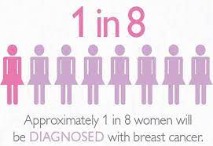
Introduction
-Increasing cases of breast cancer
-Need of spreading awareness
-how neural networks can help
-advantages of using neural networks for prediction

Slide 3
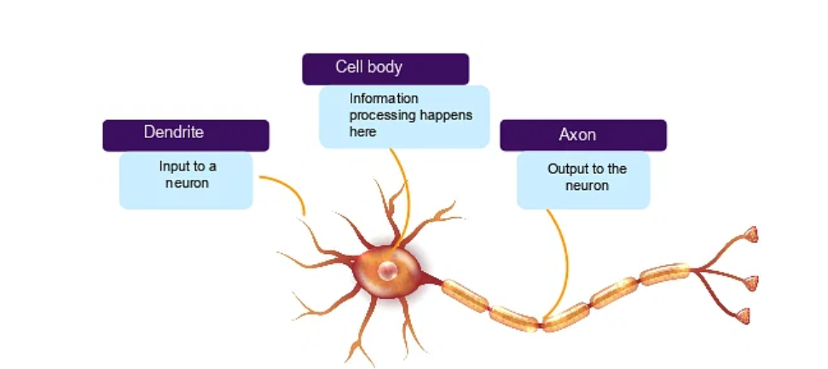
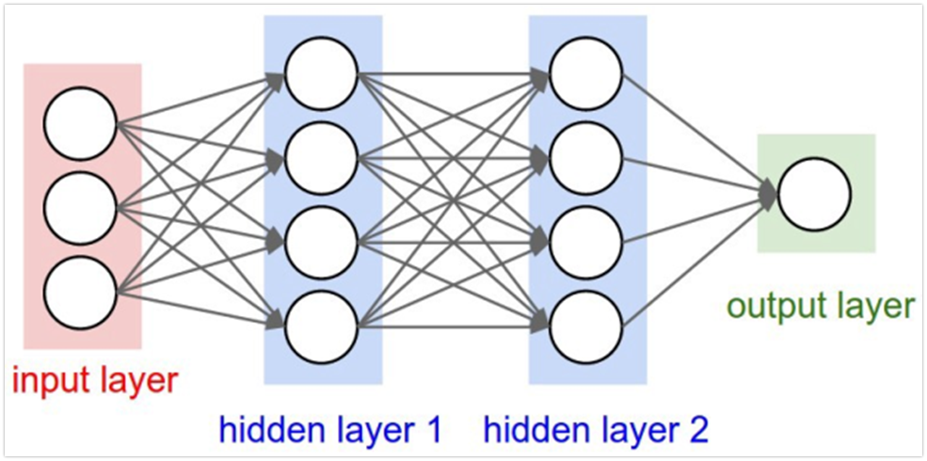
Neural Networks
Its important to understand how a biological neuron works first before understanding how the artificial neurons work .

Slide 4
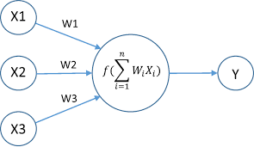
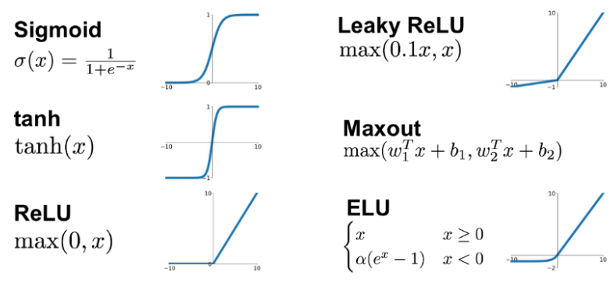
Let’s talk about activation function and mean square error
Activation function is the function used to obtain the output of the neuron. There are two types of operations: linear and nonlinear (the above operations are operations). A non-linear function is often used as it allows the model to be optimized for various data.

Slide 5
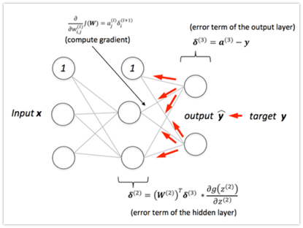
Back Propagation
Back propagation refers to how changing the weight and bias in the network changes the error.
The purpose of backpropagation is to calculate the partial derivatives Dw and Dbo of the error function E with each weight w or deviation b in the network.

Slide 6
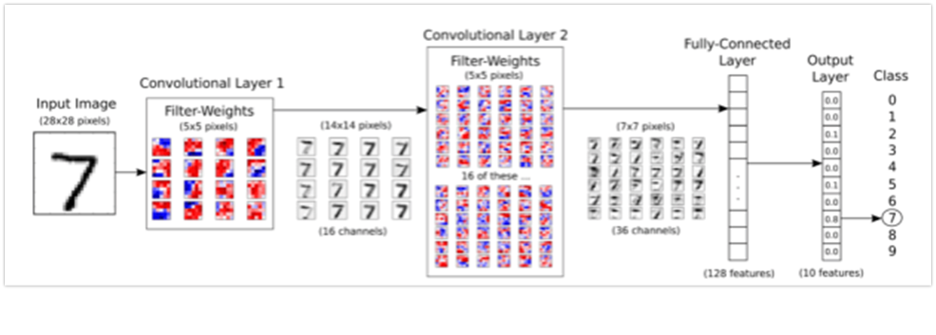
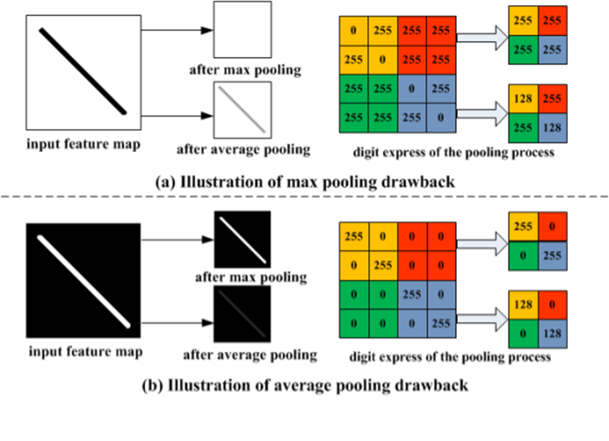
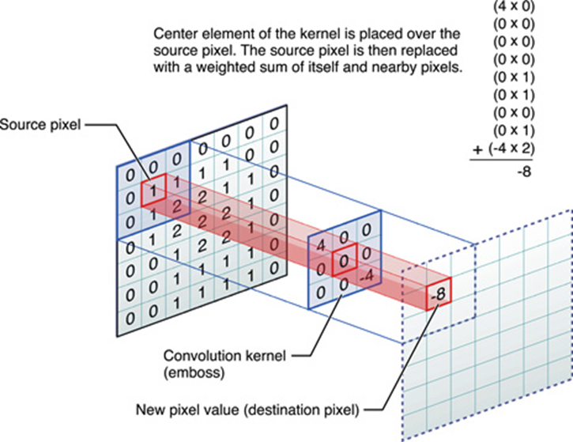
CNN
CNN
Pooling
Convolution Layer

Slide 7
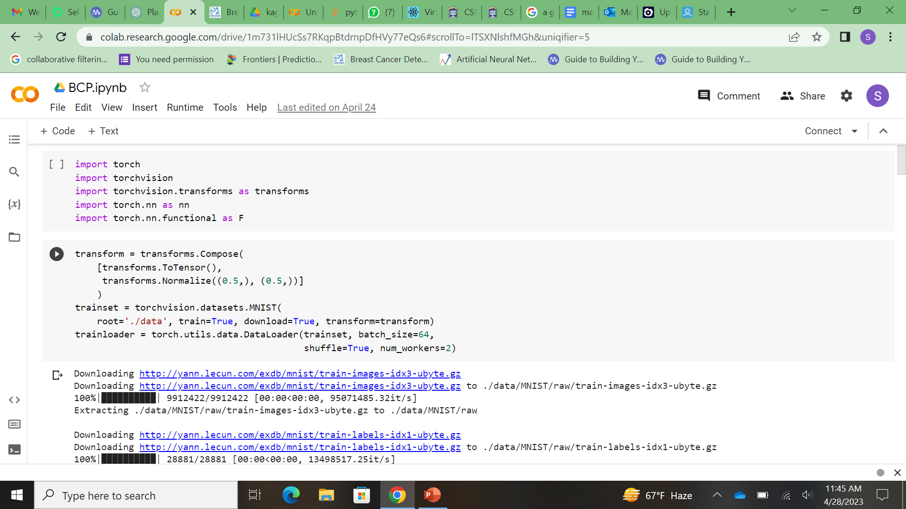
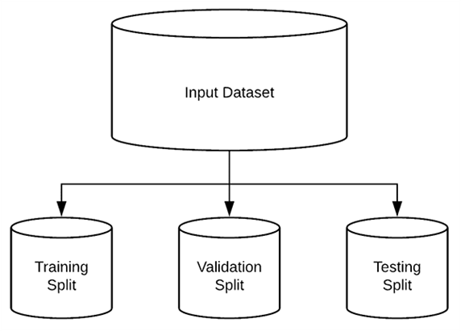
Dataset and Code
Existing dataset from Kaggle
Building our own CNN and importing the libraries , downloading the testing and training dataset
Training the images that will be used as an input .

Slide 8
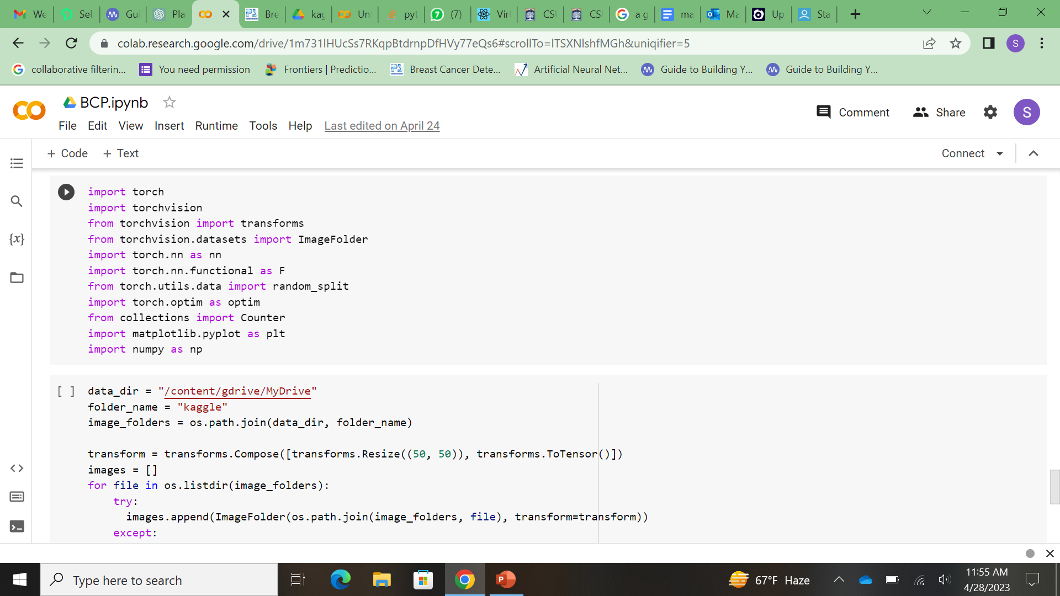
Model Training
Training the model
Mounting google drive to colab
Configuring Kaggle environment , importing os and downloading the data
Converting the images to tensor
Splitting the dataset - 75% of it being the training set and 25 being the testing set
Using the GPU and building breast classification neural network
Using binary entropy loss
Final training
Testing the trained model and calculating the accuracy.

Slide 9
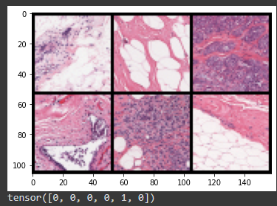
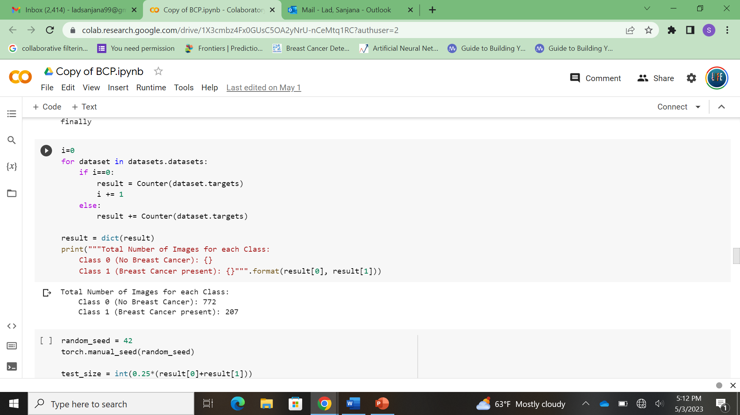

Output

Slide 10
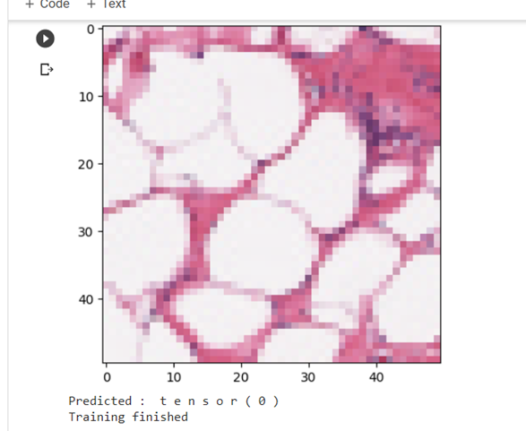
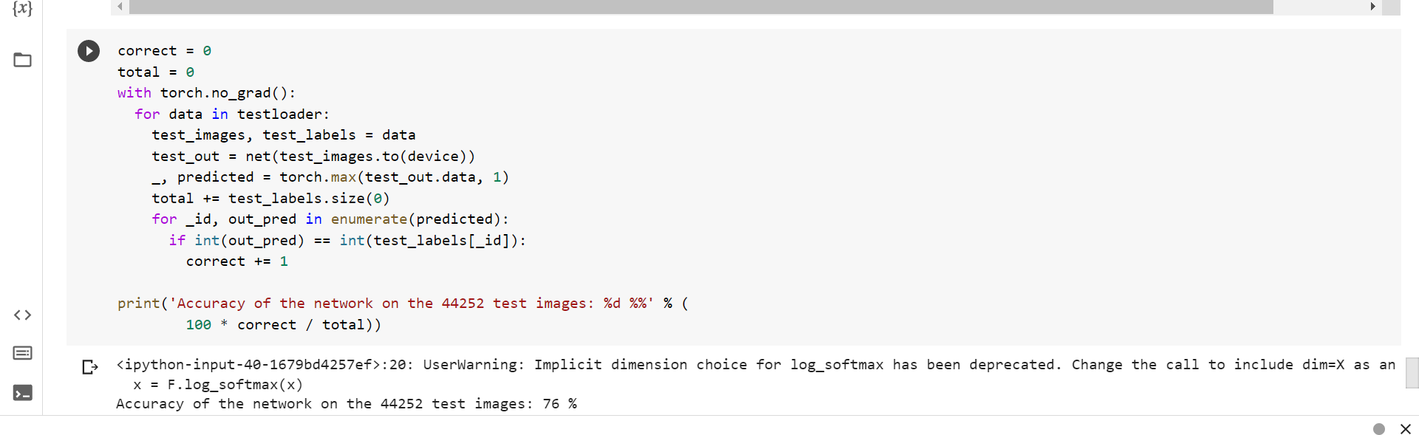
Accuracy

Slide 11
Conclusion :-
We went from defining a neural network to building our own breast cancer classification neural network.
First we looked at the definition of neural network. What do neurons represent and how do they form a network!
We took a closer look at the backward propagation and briefly explained their numbers. We moved on to the CNN and each layer, and then built our own CNN from scratch to classify the MNIST/kaggle data. Using our collective knowledge of neural networks, we created our own breast cancer neural network.
We can also further train our models to achieve higher accuracy with different datasets for precision.

Slide 12
Questions ?

Slide 13
Thank You !

